Slide 1

Introduction to Python
February 4, 2021
Mike Babb, Ph.C.
Center for Social Science Computation and Research
Department of Geography, UW

Slide 2
Workshop material
Workshop material:
https://github.com/mike-babb/intro_to_python
Google colab:
https://colab.research.google.com/notebooks/intro.ipynb
Note: you must have a google account to run the notebooks

Slide 3
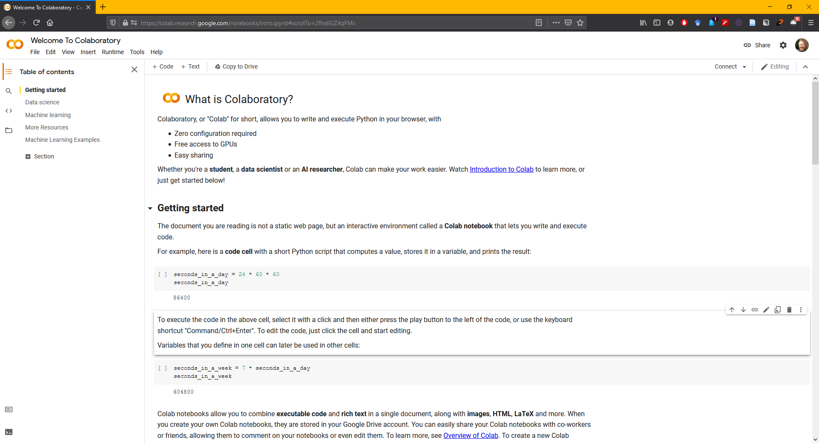
https://colab.research.google.com/notebooks/intro.ipynb

Slide 4
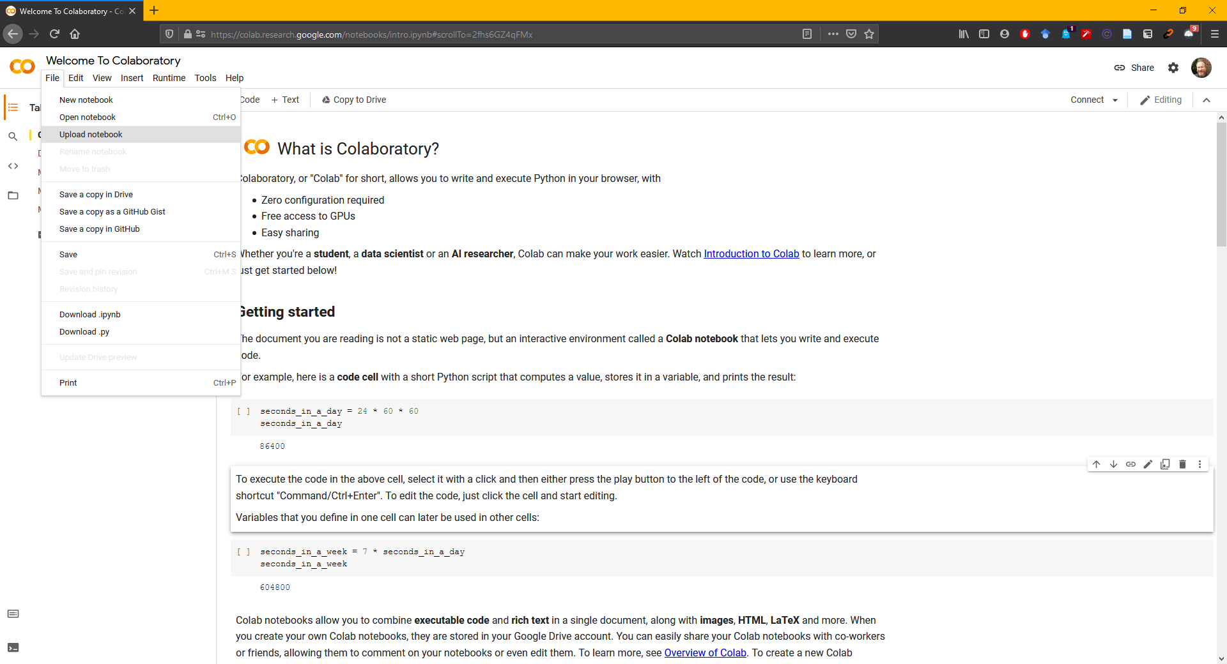
Upload a notebook

Slide 5
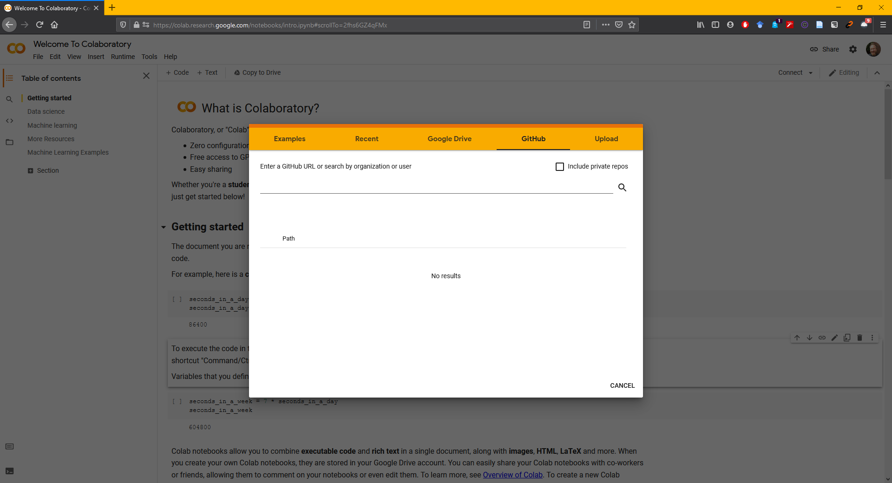
Select GitHub

Slide 6
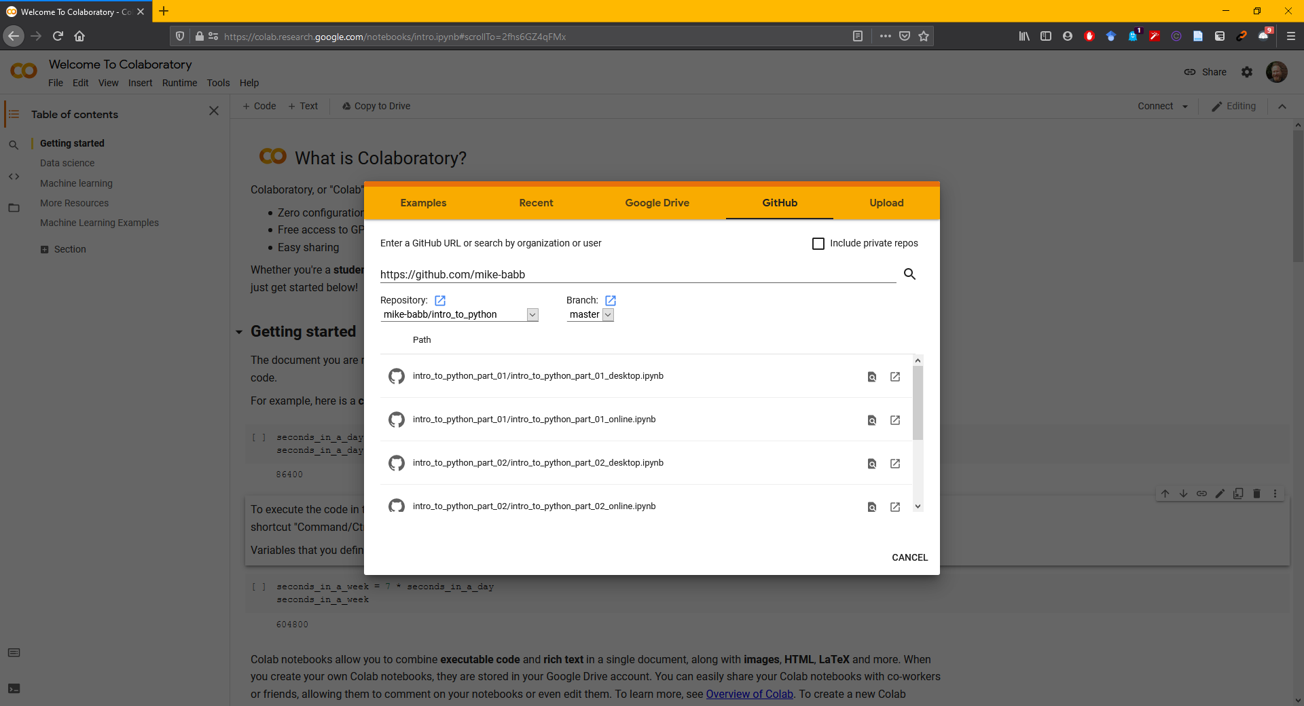
https://github.com/mike-babb/intro_to_python

Slide 7
We will use the following notebooks
intro_to_python_part_01/intro_to_python_part_01_online.ipynb
intro_to_python_part_02/intro_to_python_part_02_online.ipynb
intro_to_python_part_03/intro_to_python_part_03_online.ipynb
Each *_online.ipynb notebook can be opened through colab.
*_online.ipynb notebooks work through colab and the *_desktop.ipynb notebooks work through Anaconda.

Slide 8
Activities
Part 1: Examine basic python syntax
Strings and numbers!
Part 2: Find anagrams
What words can we spell with the letters in the word ‘time’?
Part 3: Construct the all ages sex ratio
Read in data pertaining to the age and sex of the population of Census Designated Places in Washington State during the 2013-2017 time period
Compute the all ages sex-ratio (number of males per 100 females)
Export the data to a .csv and an Excel workbook
Merge the sex-ratio data with a shapefile for mapping in a GIS

Slide 9
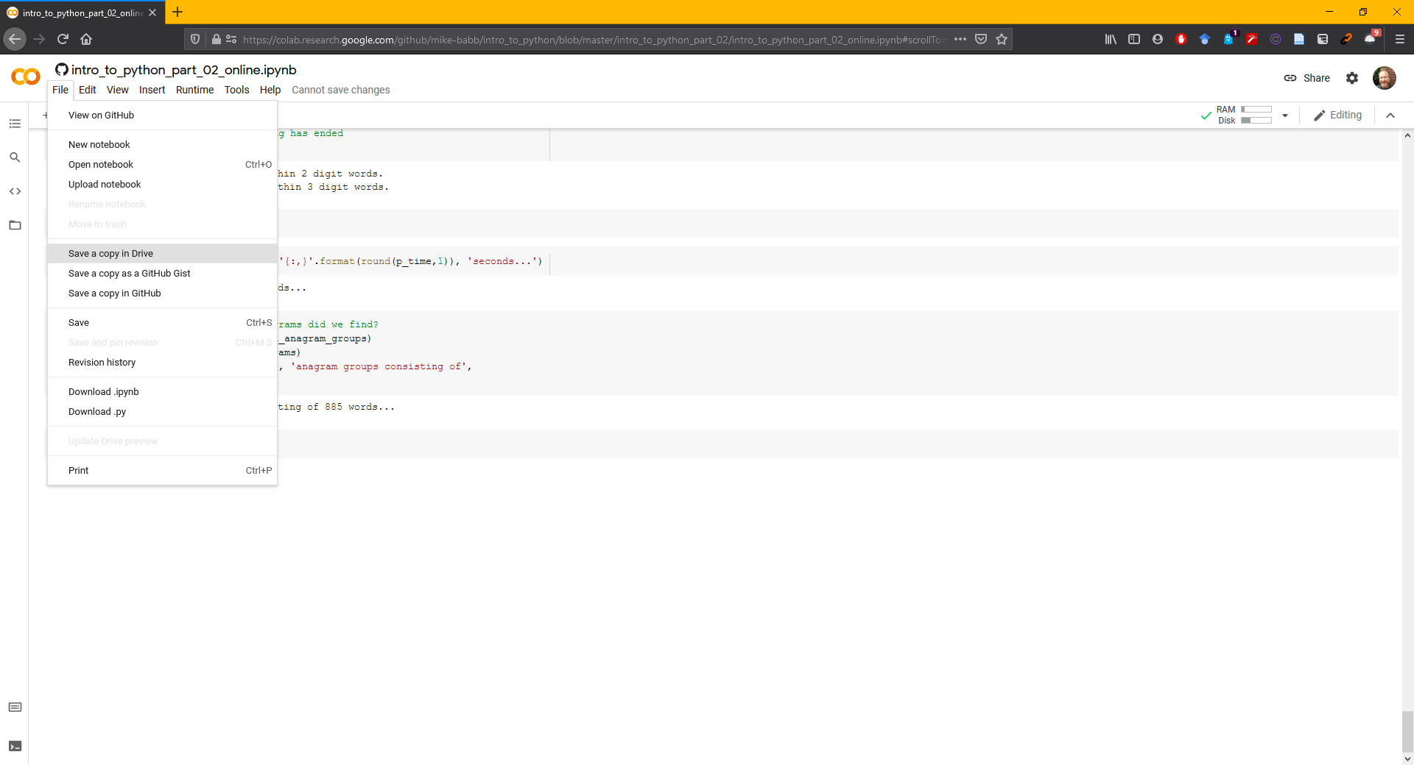
Saving a notebook to your google drive

Slide 10
Python and Workshop Information

Slide 11
Why python?
It’s easy to jump in: https://www.python.org/about/gettingstarted/
It’s cross-platform: Windows, Mac, Linux
It was designed to be simple and readable: https://xkcd.com/353/
It’s free and open source
It’s popular: https://www.tiobe.com/tiobe-index/python/
It’s prolific: used in many industries for many jobs. Finance, real estate tech, server administration, health care research, non-profit administration
And departments across campus: sociology, economics, civil engineering, astronomy (and geography!)
Many libraries that do pretty much what you want with just a few commands

Slide 12
About Python
Developed by Guido van Rossum in the early 90s. Current versions: Python 3.7.x and Python 2.7.x
Python 3.7.x is van Rossum’s (and the larger community’s) attempt at fixing some core issues with python 2.x
Integer division returns floats (5 / 2 = 2.5 instead of 5/2 = 2)
Better handling of strings
Better memory management in some cases
It’s a bit faster in general: https://hackernoon.com/which-is-the-fastest-version-of-python-2ae7c61a6b2b

Slide 13
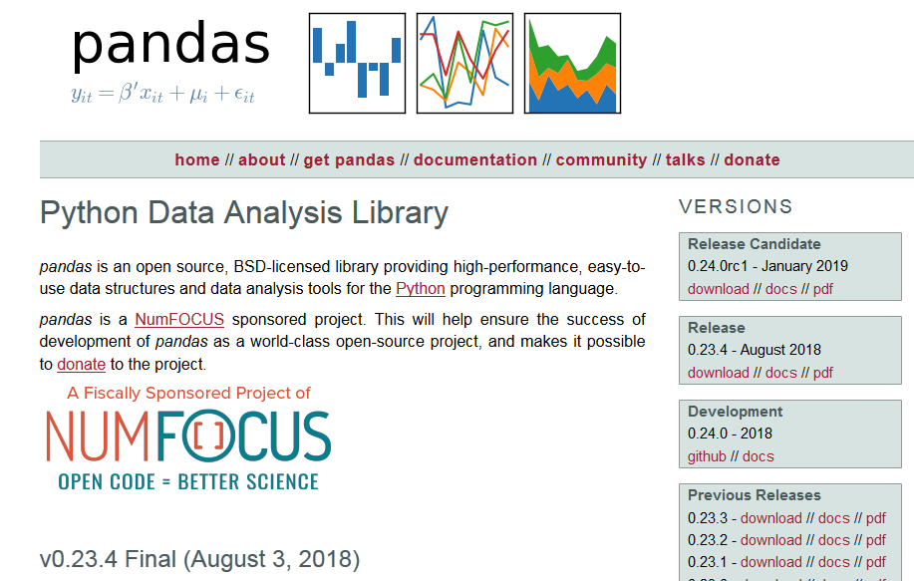
Pandas – Python Data Analysis Library
https://pandas.pydata.org/

Slide 14
Using Jupyter on the Desktop

Slide 15
Anaconda and the Jupyter Notebook
https://www.anaconda.com/
Available for Mac, Linux, and Windows
THE python data-science platform
Facilitates interactive python
Good for sharing and instruction
Easy to break code into manageable chunks

Slide 16
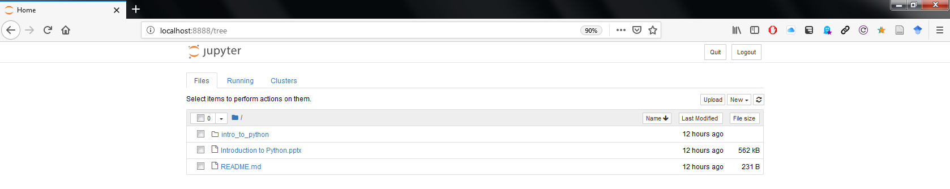
Jupyter Notebook Homepage

Slide 17
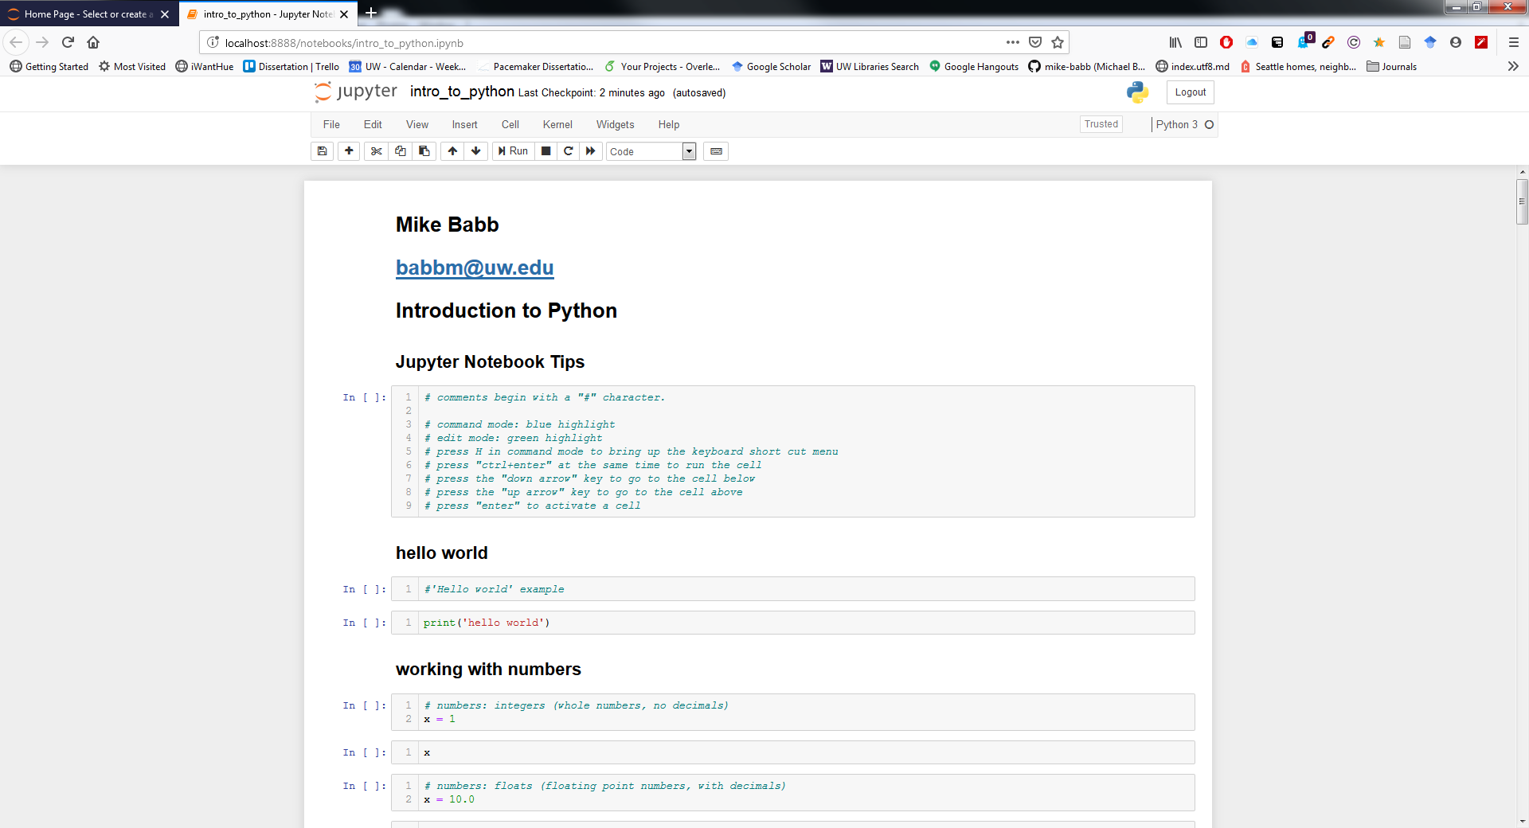
Jupyter Notebook Terminal

Slide 18
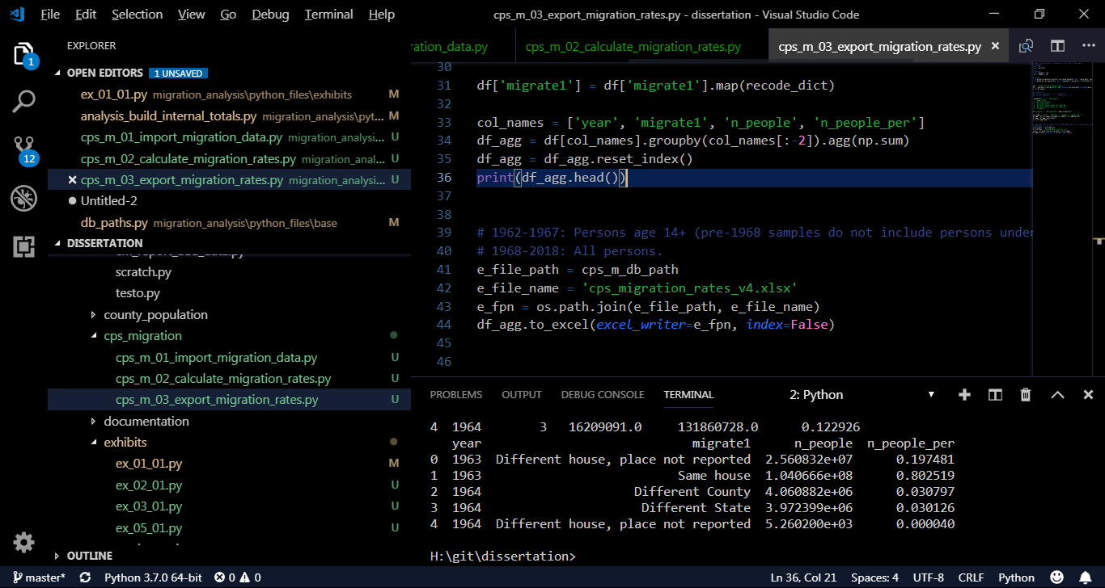
Python in… Visual studio Code
https://code.visualstudio.com/

Slide 19
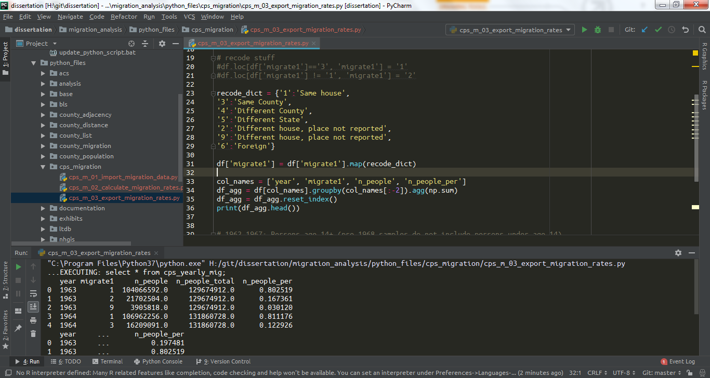
Python in… PyCharm
https://www.jetbrains.com/pycharm/

Slide 20
Additional information on sex ratios
https://www.pnas.org/content/112/16/E2102
https://www.populationpyramid.net/united-states-of-america/2017/
http://science.sciencemag.org/content/297/5589/2008

Slide 21
Data Sources
American Fact Finder
https://factfinder.census.gov/faces/nav/jsf/pages/index.xhtml
Place geography
https://www.census.gov/geo/maps-data/data/tiger.html

Slide 22
Finally… Python or R?
Both
https://github.com/matloff/R-vs.-Python-for-Data-Science

